Slide 1
Tumor Detection and classification of MRI Brain Image Using Wavelet Transformation and Svm

Slide 2
Aim
Identify a brain tumor level using segmentation of Magnetic Resonance Image (MRI) in image processing.
To split a group of data from real time dataset to identify level of brain tumor using machine learning and support vector machine.
It can detect a level of tumor Malignant or Benign in present dataset.
Malignant are not curable and Benign are curable.

Slide 3
Objectives
Image segmentation holds an important position in the area of medical image processing.
Segmentation can be used to detect tumor from MRI image.
Different segmentation methods have been used for tumor detection but it is time consuming process and also gives inaccurate result.
So, computer aided system can be designed for accurate brain tumor detection from MRI images.
Primary brain tumors do not spread to other body parts and can be malignant or benign and secondary brain tumors are always malignant.

Slide 4
Abstract
An efficient brain tumor detection method, which can detect tumor and locate it in the brain MRI images.
This method extracts the tumor by using Fuzzy clustering algorithm followed by Watershed segmentation.
Also, some preprocessing step (median filtering and morphological operation) are used for tumor detection purpose.
The detection and classification of MRI brain tumors are implemented using different wavelet transforms and support vector machines
It is observed that the experimental results of the proposed method gives better result in comparison to other techniques.
Accurate and automated classification of MRI brain images is extremely important for medical analysis and interpretation.

Slide 5
Existing System
It Extracts the tumor by using thresholding method.
Existing brain tumor detection methods are based on different learning algorithms (K-means,Texture Segmentation method etc.,)
The PSNR value of these compression methods are provide the low value than our proposed method.
Iwmp method using Psnr Value 12.275008808004

Slide 6
Drawbacks
In thresholding, Region Growing Identity(RGI) from the image background, chosen in the range of 0 to 255
That clustering methods followed by threshold cannot detect tumor properly from MRI image
Because image consist of several non brain tumor tissue.

Slide 7
Proposed System
By using machine learning algorithm we implements this project with two types. They are Load Image Data Set.
We implemented other process to split data.
In Image Dataset when uploading image data for analyses process will be done with conversion of image.
It implemented in separate modules pre-processing, Noise removal, Wavelet Transform and Svm, Texture Segmentation, Separation, Enhancement.
Compare with K-Means, Texture Segment and Watershed to predict accuracy time and error.

Slide 8
Advantages
Easily Identifies the tumor region
It can predict a type of tumor
It classified a type as M(Malignant) Or Benign.
Best accuracy rate of prediction.

Slide 9
Hardware Requirement
Processor : Intel i3
RAM : 4GB RAM
Hard Disk : 360 GB
Input Device : Logitech Keyboard & Mouse
Monitor : LG 18 inch Led monitor

Slide 10
Software Requirement
Operating System : Windows7
Technology : Mat lab 2014a
Implementation : Algorithms

Slide 11
Techniques
Fuzzy Clustering
Texture segmentation
Watershed algorithm
SVM
Benchmark Evaluation

Slide 12
Block Diagram
Load Image
Pre-Process
Enhancement
Segmentation
Wavelet Transform and Svm
Analysis
Normal/ Abnormal

Slide 13
Modules
Grey Scale Conversion
Pre processing
Denoised Image
Wavelet Transform with Svm
Region Growing Identify
Normal/ Abnormal

Slide 14
Grayscale Conversion
The luminance of a pixel value of a grayscale image ranges from 0 to 255. The conversion of a color image into a grayscale image is converting the RGB values (24 bit) into grayscale value (8 bit). Various image processing techniques and software applications converts color image to grayscale image

Slide 15
Preprocessing
In noise removal process, Initially we convert the image in gray. And then we filter the noise from the image.
In Filtering we are applying Gaussian filtering to our input image.
Gaussian filtering is often used to remove the noise from the image.
Here we used wiener2 function to our input image.
Gaussian filter is windowed filter of linear class, by its nature is weighted mean.

Slide 16
Denoised Image
One of the fundamental challenges in the field of image processing and computer vision is image denoising, where the underlying goal is to estimate the original image by suppressing noise from a noise-contaminated version of the image.

Slide 17
Wavelet Transform and SVM
A wavelet transform (WT) is the decomposition of a signal into a set of basis functions consisting of contractions, expansions, and translations of a mother function ψ(t), called the wavelet
A Support Vector Machine (SVM) is a discriminative classifier formally defined by a separating hyper plane.
In other words, given labeled training data (supervised learning), the algorithm outputs an optimal hyper plane which categorizes new examples.

Slide 18
Region Grow Identify
The fundamental drawback of histogram-based region detection is that histograms provide no spatial information (only the distribution of gray levels).
Choose the seed pixel
(2) Check the neighboring pixels and add them to the region if they are similar to the image
(3) Repeat step 2 for each of the newly added pixels; stop if no more pixels can be added.

Slide 19
Analysis
Peak Signal-to-Noise Ratio, often abbreviated PSNR,
It is an engineering term for the ratio between the maximum possible power of a signal and the power of corrupting noise that affects the fidelity of its representation.
Because many signals have a very wide dynamic range, PSNR is usually expressed in terms of the logarithmic decibel scale.
Compression ratio is a value that represents the ratio of the volume of its combustion chamber from its largest capacity to its smallest capacity

Slide 20
Normal / Abnormal
After all the separation and segmentation process is completed we find the affected area in the certain level .
It denotes as Benign as a normal and Malignant as an abnormal
Final stage to identify a level of tumor cell present in brain

Slide 21
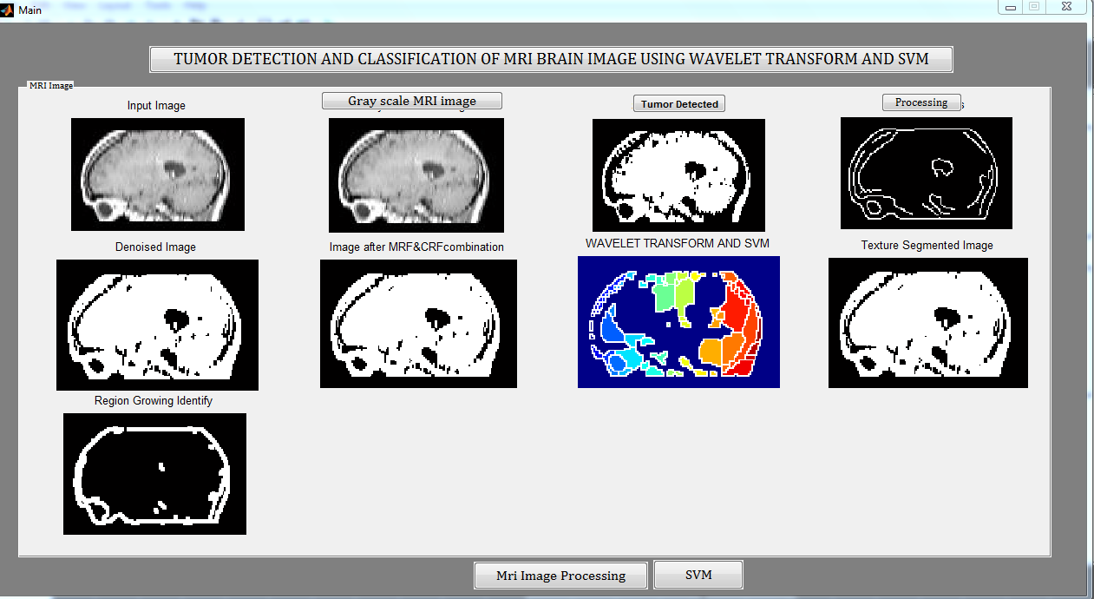
Screenshots

Slide 22
Screenshots

Slide 23
Screenshots

Slide 24
Screenshots

Slide 25
Screenshots

Slide 26
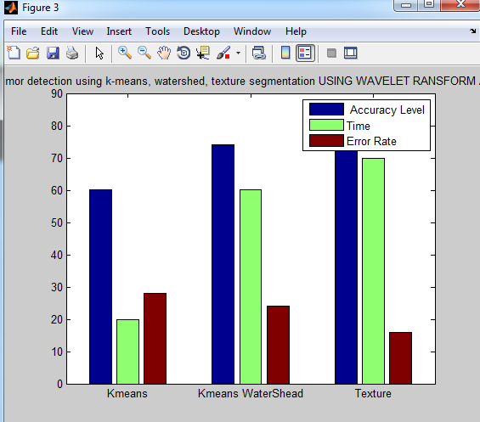
Screenshots

Slide 27
Conclusion
The brain tumor detection and classification system is implemented using K-Means, Texture Segmentation and SVMs.
The proposed method uses different levels for wavelets, the high accuracy part is obtained using texture segmentation. It prevents the loss of edges in segmentation.
The result shows that SVMs having the proper sets of training data are able to distinguish between abnormal and normal tumor regions and classify them correctly as a benign tumor, malign tumor or healthy brain. In practice, SVMs have significant computational advantages.

Slide 28
Future Enhancement
In future work this method exhibits an elegant and methodological choice of the threshold parameter. It also outperforms previous rule-based segmentation technique. The assessment of the Bayesian classification with regard to the colour reveals a close performance across the different colour spaces for a histogram resolution above 64. However, it should be noted that a slight advance of the HSV representation has been noticed. With regard to the colour quantization, we found that a larger histogram size (finer color quantization) gives better cell detection result.

Slide 29
References
S.Grgic,M.Grgic, B.Zovko-cihlar,Performance analysis of image compression using wavelets, IEEE Trans.Ind.Electron. 48(2010) 682-695.
J.Askelof,M.Carlander,C.Christopoulos, Region of interest coding in JPEG2000, Signal Process,image Commun,17 (2012) 105-111
A.said and W.Pearlman, A new, fast and efficient image codec based on set partitioning, IEEE Trans.Circuits Syst.VideoTechnol..6,pp.243-250,.(2016)
Martin, K. Lukac, R. Plataniotis, K.N., SPIHT-Based Coding of the Shape and Texture of Arbitrarily Shaped Visual Objects, IEEE Transactions on Circuits and Systems for Video Technology, 16(10), pp. 1196-1208,(2016)

